Slide 1

CMR COLLEGE OF ENGINEERING AND TECHNOLOGY
UAV for Landmine Detecction
Major Project
Under the Esteemed Guidance of
Dr K.Srinivasa Rao
Professor
Dept. of Mechanical engineering
Presented By
K.Eshwar teja
Mohana krishna K
V.Sudeep
B.Jagapathi babu
17H51A0381
17H51A0397
17H51A03B2
17H51A0367

Slide 2
Abstract
Explosive landmines have cost the lives of hundreds in several countries.
Our project presents a field report of a low cost unmanned aerial vehicle -ARdrone - used as a complemented tool for landmine visual detection in rural scenarios.
The main contribution of this work is the practical experimentation with an integrated tool. This tool is composed by the ARdrone quadrotor and a base station for monitoring the mission.
Experiments have been carried out to quantify the performance of the platform by means of measuring the percentage of the detection at different set of flight speeds and altitudes.
The visual methods introduced herein might enable the ARdrone quadrotor to be used as a low-cost autonomous platform for safe area coverage applied to landmine detection in real scenarios.

Slide 3
Objectives
The objective of explosives-detection equipment is to detect certain types and amounts of explosive material with a high detection rate and also with a low false-alarm rate.
Our goal in this project is to integrate and evaluate a set of low cost technologies that allow the detection of explosive landmines autonomously and without compromising the mission.
The goal is not only to detect fully visible landmines but also those partially buried. It has been observed an effective percentage of the detection over 80% when flying at low altitudes about 1m from the ground at speeds up to 2.2m/s. A metal detecting sensor is placed at the bottom of the quad copter drone to detect the metal specimen present on the ground.When an amount of metal is identified by sensor, it is designed to produce a sound to alert the surroundings and a camera which is attached to the drone helps us to detect the material with greater ease.

Slide 4
Literature Review
Manuel Ricardo et al. [1] presented an approach for explosive-landmine detection on-board an autonomous aerial drone.They analysed the design, implementation and integration of a ground penetrating radar (GPR) using a software defined radio (SDR) platform into the aerial drone.Ground-penetrating radar (GPR) technique is successfully deployed with the aim of addressing important sensing problems that requires detection, imaging and identification of dielectric material discontinuities in the subsurface through the use of radio waves, providing a non-invasive method to probe the ground.
C.Castiblanco et al. [2] presented a field report of a low cost unmanned aerial vehicle -ARdrone 2.0- used as a complemented tool for landmine visual detection in rural scenarios.The main aim of this work is the practical experimentation with an integrated tool. This tool is composed by the ARdrone quadrotor. It has been observed an effective percentage of the detection over 80% when flying at low altitudes about 1m from the ground at speeds up to 2.2m/s .

Slide 5
Aashish Raj et al. [3] studied the application of the concept of swarm robotics for the purpose of landmine detection. Swarm robotics is the technique where multiple robots are operating parallel in a synchronous manner to attain a common objective. In this project they used pure concept of swarm robotics with help of autobots, which are able to carry out the given task with the help of other bots. As per the concept of auto-bot here they used a UAV, which is able to sense the landmines in the warzones.
Rajesh Kannan Megalingam et al. [4] presented the research work of a simple bot to detect landmines and mark their locations using autonomous navigation using a simple Zumo32U4 robot. This light weight, autonomous wireless controlled robot which is capable of detecting the landmine at the depth of 5cm to 9cm under group.

Slide 6
Introduction
An Unmanned Aerial Vehicle (UAV), commonly known as a drone, as an unmanned aircraft system (UAS), and also referred by several other names, is an aircraft without a human pilot aboard.
The flight of UAVs may be controlled with various kinds of autonomy: either by a given degree of remote control from an operator, located on the ground or in another vehicle, or fully autonomously, by onboard computers.
UAVs are often preferred for missions that are too dangerous for manned aircraft.
The work here is divided into two categories landmines detection and mapping which will be implemented using the principle of electromagnetic induction for the detection of landmines.

Slide 7
Idea Behind the Development
The reason that demining drones (or landmine detection drones) are so important is that landmines kill people every day all over the world.
While some of these deaths happen in places where there is an ongoing armed conflict, like Syria or Afghanistan, they are also happening in places like Vietnam, where the war ended decades ago.
Since 1975, land-mines have exploded under more than 1 million people and are currently thought to be killing 800 people a month. There seems little prospect of any end to the carnage. In 64 countries around the world, there are an estimated 110 million land-mines still lodged in the ground—waiting.

Slide 8
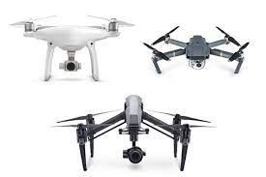
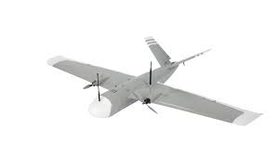
DRONE
An Unmanned Aerial Vehicle (UAV) is defined as a powered, aerial vehicle that does not carry a human operator, uses aerodynamic forces to provide vehicle lift, can fly autonomously or be piloted remotely, can be expendable or recoverable, and can carry a lethal or nonlethal payload.
TYPES OF DRONES:
MULTI ROTOR DRONES:
FIXED WING DRONES:

Slide 9
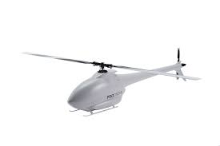
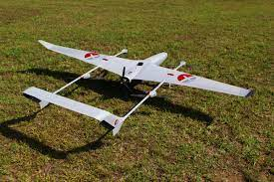
SINGLE ROTOR HELICOPTER:
FIXED WING HYBRID VTOL:

Slide 10
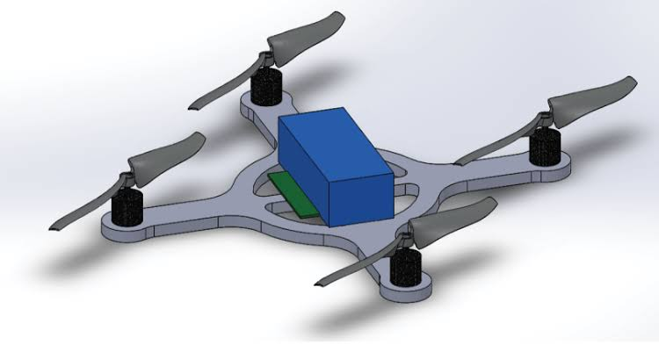
Components of a Drone
Motors
ESC(Electronic Speed Control)
Propeller
Power Distribution Board
Batteries
Frame
Remote Control

Slide 11
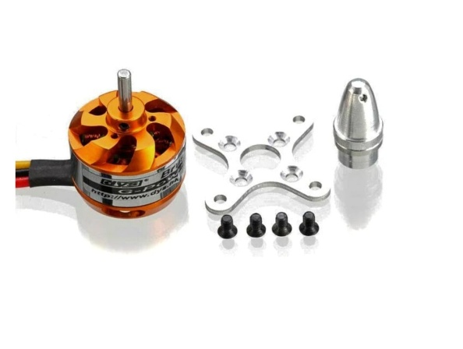
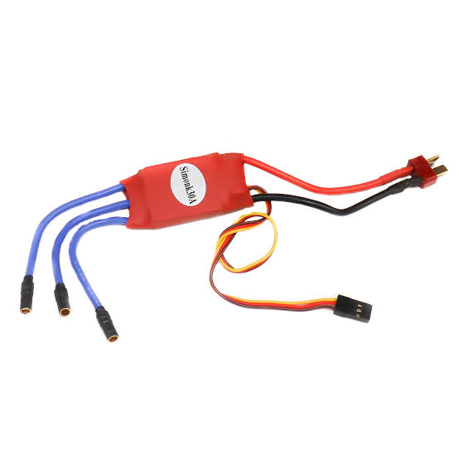
D.C Motors: A Brushless DC motor is an internally commutated electric motor designed to be run from a direct current power source. Brushed DC motors
can be varied in speed by changing the operating voltage or the strength of the magnetic field.
Electronic Speed Control: An electronic speed control or ESC is an elect-ronic circuit with the purpose to vary an electric motor's speed, its direction and possibly also to act as a dynamic brake.

Slide 12
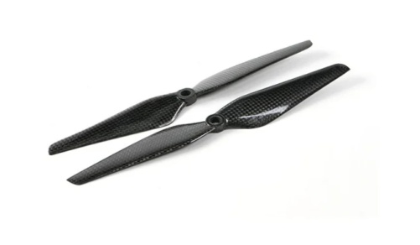
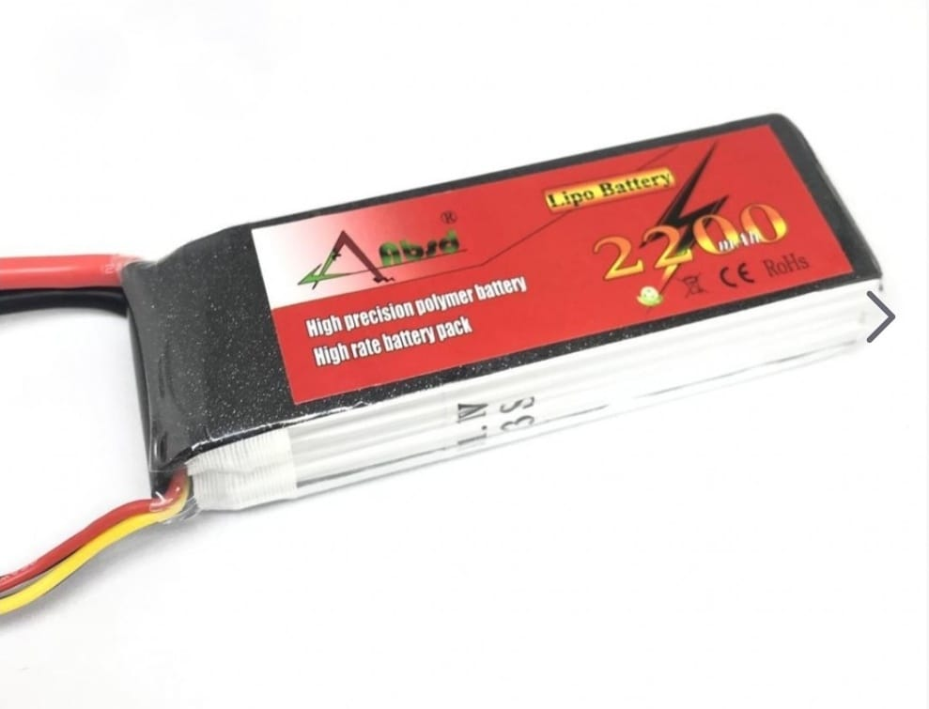
Propellers: A Propeller is a type of fan that converts rotational motion into thrust and transmit the generated power. There are three simple measurements to keep in mind .The first is length Usually given in inches. The higher the Kv of your motors, the smaller your props need to be. Smaller props allow for greater speeds, but reduced efficiency.
Battery: A lithium polymer battery, or more correctly lithium-ion polymer batt-ery (abbreviated variously as LiPo, LIP, Li-poly and others), is a rechargeable battery of lithium-ion technology using a polymer electrolyte instead of the m-ore common quid electrolyte.

Slide 13
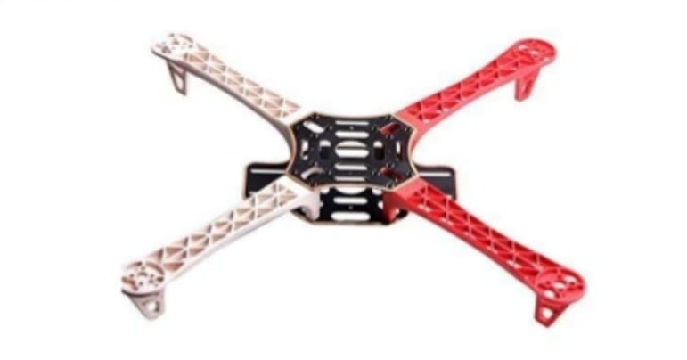
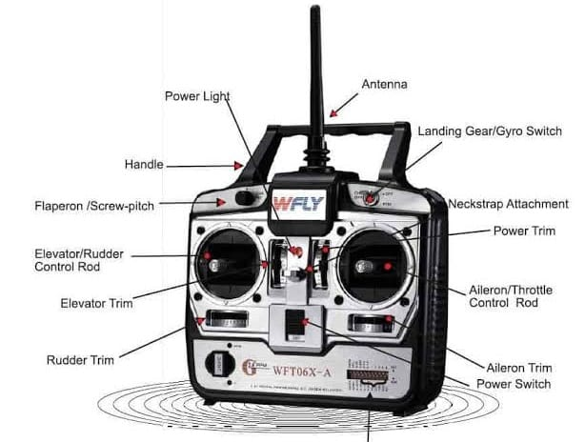
Frame: This is the most important basic part of a Quadcopter As the name
incidates the copter has 4 arms The frame should be light as well as rigid to host a LIPO battery 4 BLDC motors,4 ESC & controller.
Remote control: We need a RC Transmitter(2.4GHz RC radio transmitter) to direct the quadcopter direction and position . A 2.4GHz RC radio on the
Quadcopter receives commands from the RC transmitter on the ground. It will be paired with a Receiver along with the corresponding Transmitter.

Slide 14
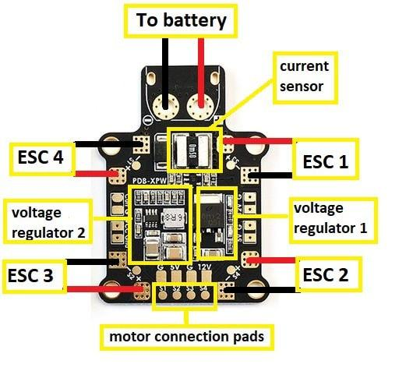
Power Distribution board(PDB): A Power Distribution Board is also known as PDB. PDB essentially distributes the power from the battery to the drone.The PDB also distributes power to some other peripherals such as FPV video transmitters,FPV cameras and the Quadcopter flight controller.

Slide 15
Preliminary approach to flight dynamics
The quadcopter’s movement is controlled by varying the relative thrusts of each of the 4 rotors. These rotors are aligned in a diamond. Motors on one diagonal rotate in the clockwise direction and on the other in the anti-clockwise direction.
To move forward we reduce the power in the front motor. This tilts the quadcopter forward and the rotors provide sufficient thrust to move forward. Speed is decided by the power given to the rotors.Moving back
To move backwards we reduce the power in the back rotor, tilting the quadcopter backwards and then again the thrust from the motors takes it in reverse.In addition to this, the quadcopter has 3 degrees of freedom namely:
●

Slide 16
Yaw (turning left and right) is controlled by turning up the speed of the regular rotating motors and taking away power from the counter rotating; by taking away the same amount that you put in on the regular rotors produces no extra lift (it won’t go higher) but since the counter torque is now less, the quadcopter rotates and control becomes a matter of which motor gets more power and which one gets less.
Roll(tilting left and right) is controlled by increasing speed on one motor and lowering on the opposite one.
Pitch (moving up and down, similar to nodding) is controlled the same way as roll, but using the second set of motors.

Slide 17
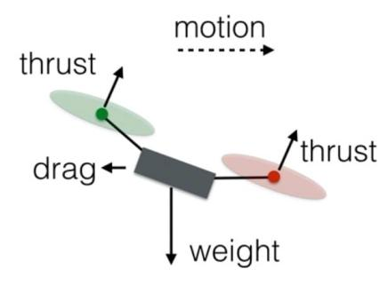
Mechanics of Drone
Drones use rotors for propulsion and control. A rotor is generally a fan as they work pretty much the same. Spinning blades push air down. Of course, all forces come in pairs, which means that as the rotor pushes down on the air, the air pushes up on the rotor. This is the basic idea behind lift, which comes down to controlling the upward and downward force. The faster the rotors spin, the greater the lift, and vice-versa .A drone can do three things in the vertical plane: hover, climb, or descend.
Hover: To hover, the net thrust of the four rotors pushing the drone up must be equal to the gravitational force pulling it down.

Slide 18
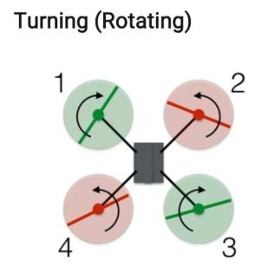
Descend: To descend, the net thrust of the four rotors pushing the drone up must be less than that of the gravitational force pulling it down. In this configuration, the red rotors are rotating counter clockwise and the green ones are rotating clockwise. With the two sets of rotors rotating in opposite directions, the total angular momentum is zero.
Forwards and Sideways:
In order to fly forward, there is a need of forward component of thrust from the rotors. Here is a side view (with forces) of a drone moving at a constant speed. The total thrust force will remain equal to the weight, so the drone will stay at the same vertical level. Also, since one of the rear rotors is spinning counterclockwise and the other clockwise, the increased rotation of those rotors will still produce zero angular momentum.

Slide 19
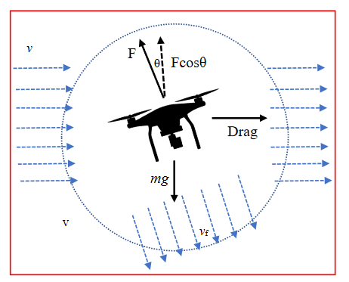
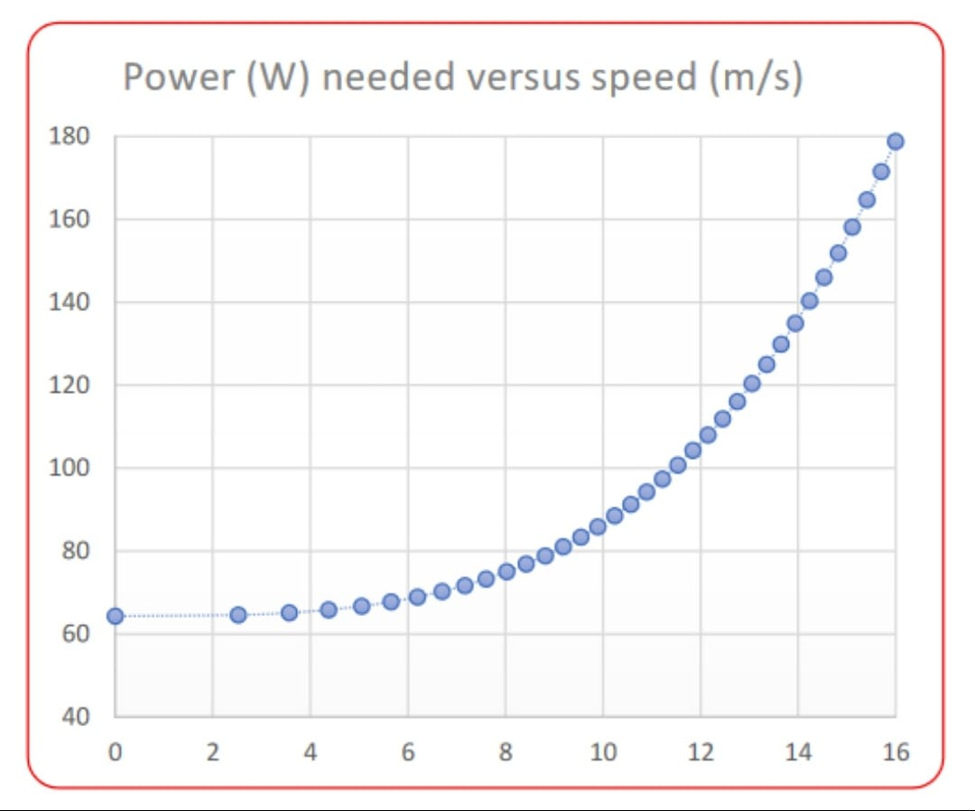
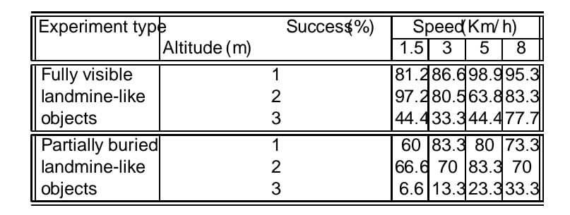
The same holds true for the front rotors, and so the drone does not rotate. However, the greater force in the back of the drone means it will tilt forward. Now a slight increase in thrust for all rotors will produce a net thrust force that has a component to balance the weight along with a forward motion component.

Slide 20
Bomb Detection
Introduction
A metal detector is an instrument that detects the presence of metal nearby. Metal detectors are useful for finding metal inclusions hidden within objects, or metal objects buried under ground. If the sensor comes near a piece of metal this is indicated by a changing tone in earphones, or a needle moving on an indicator. Usually the device gives some indication of distance; the closer the metal is, the higher the tone in the speaker.
The simplest form of a metal detector consists of an oscillator producing an alternating current that passes through a coil producing an alternating magnetic field. If a piece of electrically conductive metal is close to the coil, eddy currents will be induced (inductive sensor) in the metal, and this produces a magnetic field of its own. If another coil is used to measure the magnetic field (acting as a magnetometer), the change in the magnetic field due to the metallic object can detected.

Slide 21
Principle of Metal Detection
A metal detector contains a coil of wire (wrapped around the circular head at the end of the handle) known as the transmitter coil. When electricity flows through the coil, a magnetic field is created all around it. As you sweep the detector over the ground, you make the magnetic field move around too. If you move the detector over a metal object, the moving magnetic field affects the atoms inside the metal. In fact, it changes the way the electrons (tiny particles "orbiting" around those atoms) move. Now if we have a changing magnetic field in the metal, we must also have an electric current moving in there too. In other words, the metal detector creates (or "induces") some electrical activity in the metal. If we have electricity moving in a piece of metal, it must create some magnetism as well. So, when you move a metal detector over a piece of metal, the magnetic field coming from the detector causes another magnetic field to appear around the metal.

Slide 22
It's this second magnetic field, around the metal, that the detector picks up. The metal detector has a second coil of wire in its head (known as the receiver coil) that's connected to a circuit containing a loudspeaker. As you move the detector about over the piece of metal, the magnetic field produced by the metal cuts through the coil.
Now we move a piece of metal through a magnetic field, we make electricity flow through it. So, as we move the detector over the metal, electricity flows through the receiver coil, making the loudspeaker click or beep. The closer you move the transmitter coil to the piece of metal, the stronger the magnetic field the transmitter coil creates in it, the stronger the magnetic field the metal creates in the receiver coil, the more current that flows in the loudspeaker, and the louder the noise.

Slide 23
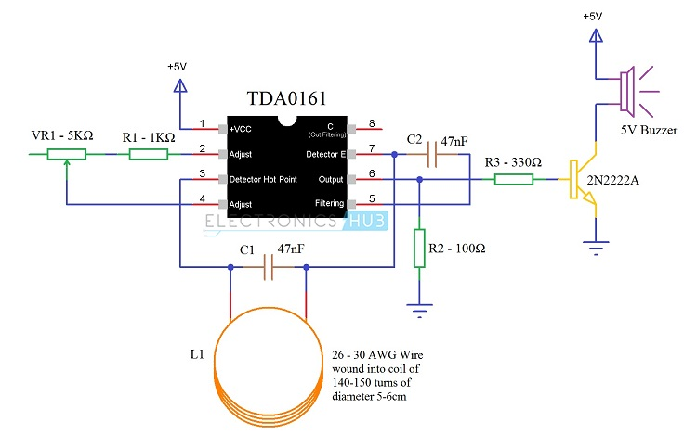
Metal Detector Circuit

Slide 24
Working of the Metal Detector
Together with the circuit and other external hardware components, the metal detector works according to the following manner
1. A battery in the top of the metal detector activates the transmitter circuit (red) that passes electricity down through a cable in the handle to the transmitter coil (red) at the bottom.
2. When electricity flows through the transmitter coil, it creates a magnetic field all around it.
3. If you sweep the detector above a metal object (such as this old gray spanner), the magnetic field penetrates right through it.
4. The magnetic field makes an electric current flow inside the metal object.
This flowing electric current creates another magnetic field all around the object. The magnetic field cuts through the receiver coil (blue) moving about up above it. The magnetic field makes electricity flow around the receiver coil and up into the receiver circuit (blue) at the top, making a loudspeaker buzz and alerting you you've found something.

Slide 25
Landmine Detection Drone
Mine fields which are left after the wars or planted by terrorists claim more than 80,000 deaths every year. 80% of the victims are of anti-personnel mines, in which most of them are children.
Anti-personnel landmines are usually buried 1-4 cm beneath the soil .
The drone which we fabricated can detect the landmine which is at a depth of 3-5cm depending upon the soil and the difference in the metals.
Unmanned Aerial Vehicles (UAV) enable several capabilities that enhance detection of landmines.
Firstly, a UAV is able to autonomously cover a larger area of any type of terrain in less time and without compromising the mission. Secondly, it can be also used as a remote sensing platform for collecting key information about the terrain. Terrain information can be acquired using visual methods based on target localization , tracking and image mosaicing techniques which might provide a better understanding about the area to be covered.
The UAV is remotely controlled from a base station.

Slide 26
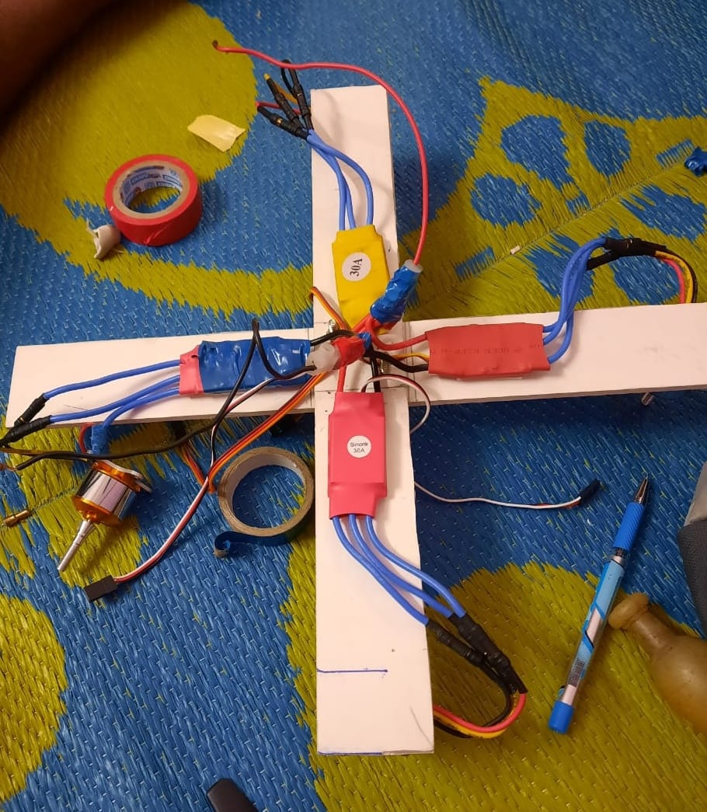
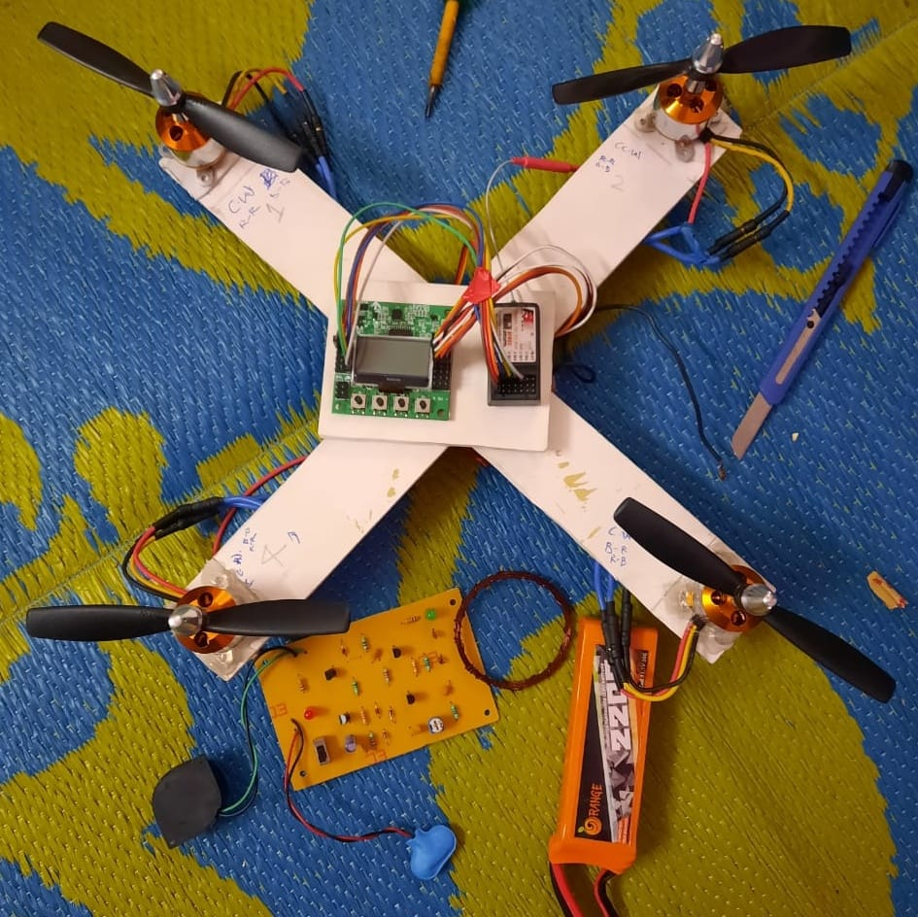
STEP BY STEP ASSEMBLY OF DRONE
Stage 1: In stage 1, we made a frame (a low cost and a light-weight frame) using PVC and fixed the Electronic speed controllers to the frame.
Stage 2: In stage 2, we attached DC motors to the frame with help of screws and glue. The DC motors are anchored with the propellers.

Slide 27
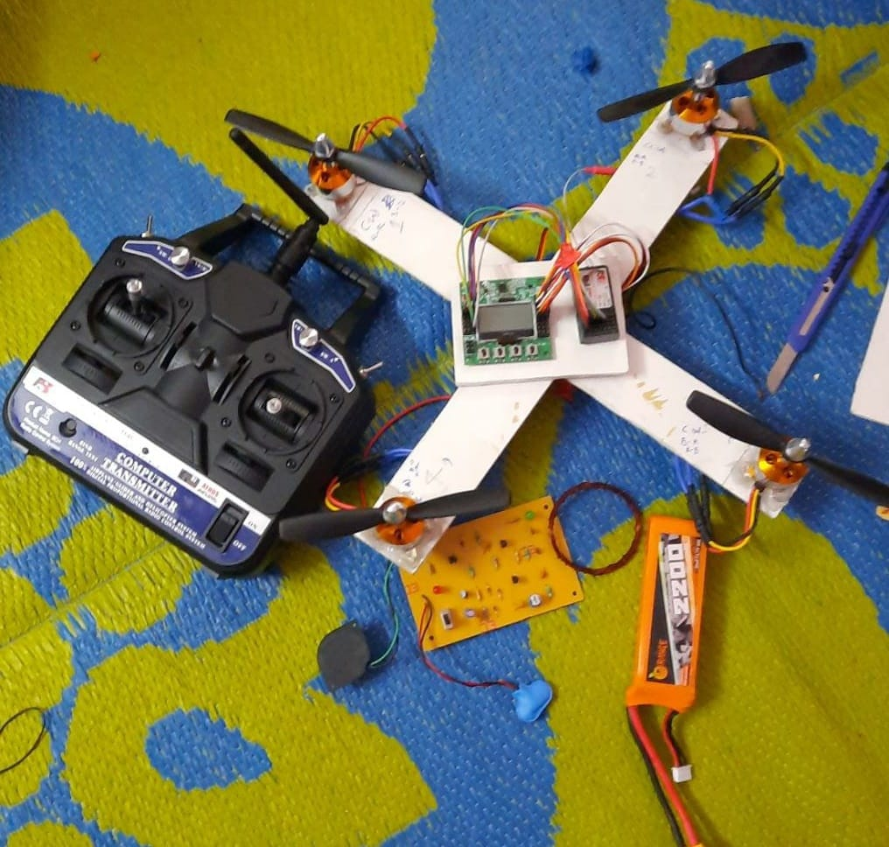
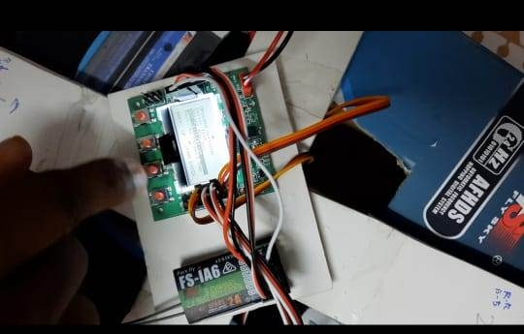
Stage 3: In stage 3, we took the battery and power distribution board. The two are fixed to the frame with help of glue and tape.
Stage 4: It invovlves setting up flight controller. We used a flight controller for setting up the throttle, elevator, rudder and also for the purpose of acceleration calibration.

Slide 28
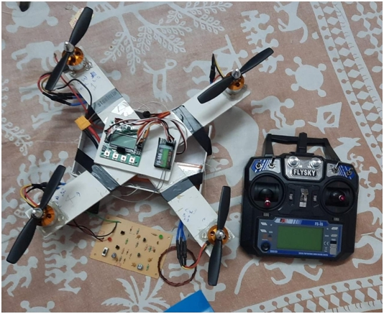
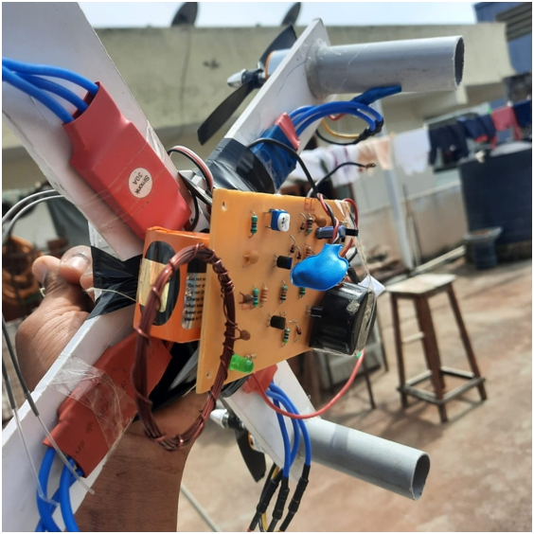
Stage 5: In this stage 5, the drone is ready to fly. At this stage the metal detector is fixed beneath the drone to identify the landmines on the ground.

Slide 29
RESULTS
Firstly, we fabricated the Quadcopter drone and done all the setup, carried out the flight test for the drone. The drone has range from 0.1m to 1m. After the flight test we have assembled the metal detector to the drone.
Our main aim is to save the lives of the people who are risking their lives in detecting the landmines.
We have placed two objects: tin sheet and a cutting plier on the ground. Then we have run the test for testing the accuracy of the metal detector with varying altitude. The drone has covered the area, where the objects are placed with a speed of 0.5m/s. At first, we have placed the objects on the ground and made the drone to fly at 2cm and the accuracy of metal detection is 99%.
We formulated our test results in the table given below. This table establishes a relationship between the altitude and the accuracy of detecting the landmine. This shows results of 10 tests carried when the metal objects are placed on the ground and the drone is hovered on it.
In the second case of our examination, we buried some of our metal specimens partially under the ground for testing the detection of partially buried landmines. We formulated our results in the below table.

Slide 30
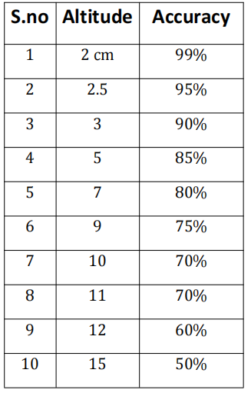
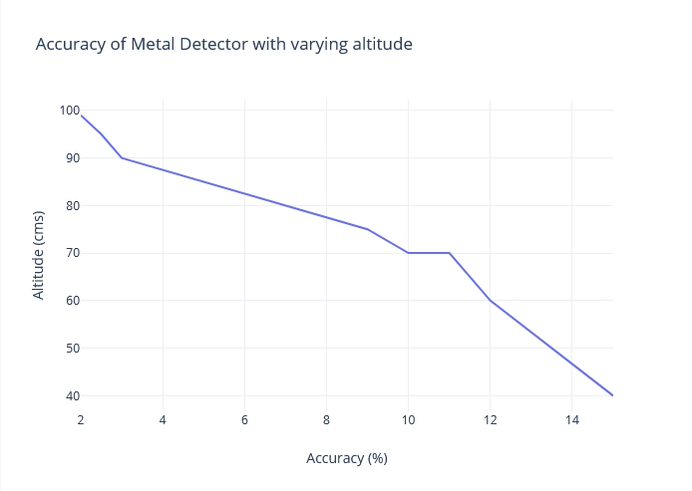
TABLE-1 : Accuracy of metal detector with varying altitude when parts not
buried.

Slide 31
TABLE-2 : Accuracy of metal detector with varying altitude when partially buried.
S.no | Altitude | Accuracy
1 | 2 cm | Good
2 | 3 cm | Moderate
3 | 4 cm | Normal
4 | 5 cm | Poor
From the above results, we incurred that when when the drone is flying at low altitudes, it is able to detect the landmine accurately. We observed that the metal detection is slightly less functional when compared to the objects placed on the ground.

Slide 32
CONCLUSION
We have presented the experimental setup and the results which point to a successful model of our proposed work.
We have run outdoor tests for landmine detection. We have tested our drone under Two parameters: altitude at which the drone flies and the accuracy of the metal detector.
We conclude that the drone we fabricated performs with a high percentage of accuracy when the drone hovers at a range of 5cm from the ground and also ensures a precise detection when the drone flies at a speed of 0.5m/s.
The designed drone for landmine detection is a cost effective material, which is an added advantage.
In all the tests, the percentage of detection was higher than 80% when flying at 7 cm of altitude at a speed at 1m/s.
Based on the experimental results, we have determined that an altitude of 1m enables higher precision during the detection. At 5cm of altitude (partially buried object) the drone featured a 33.3% of detection flying at 1 m/s.

Slide 33
REFERENCES
UAV for Landmine Detection Using SDR-Based GPR Technology, By Manuel Ricardo Pérez Cerquera, Julian David Colorado Montaño and Iván Mondragón Submitted: October 31st 2016Reviewed: May 12th 2017Published: December 20th 2017, DOI: 10.5772/intechopen.69738.
Design and Development of Heavy Drone for Fire Fighting Operation, https://www.ijert.org/design-and-development-of-heavy-drone-for-fire-fighting-operation
Drones for Good: How Drones Coupled with AI Have the Potential to Rid the World of Dangerous LandminesBY Zacc Dukowitz,https://uavcoach.com/drones-landmines/
Review on Application of Drone Systems in Precision Agriculture, https://www.sciencedirect.com/science/article/pii/S1877050918310081
https://www.instructables.com/Simple-metal-detector/

